Slide 1
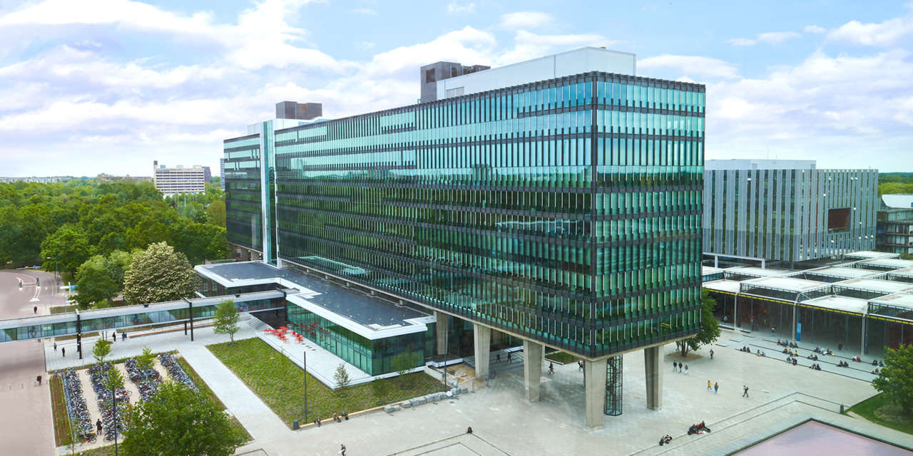
Discussion about stakeholder’s needs and defining the scope of the project
16/02/2023
Elham Honarvar, Project manager
Mechatronic System Design
Autonomous Referee

Slide 2
AGENDA
Team Registration
Stakeholder’s needs
Project activities schedule
Discuss about the requirements
Questions

Slide 3
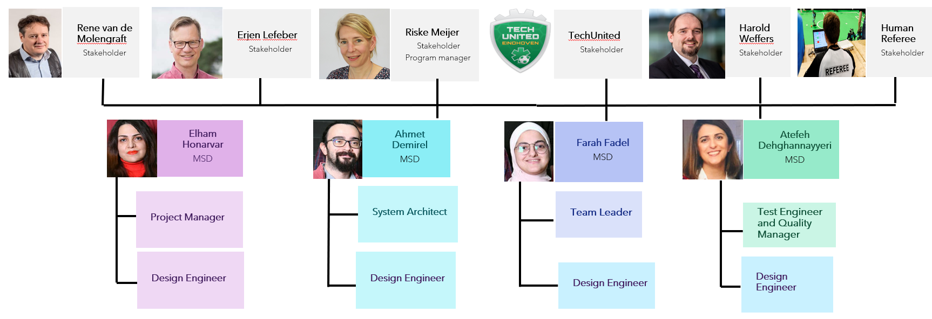
Project Organization

Slide 4
Erjen
Stakeholder’s needs(from previous group)
Rene
Human Referee
5 mins match 2 vs 2
Positive feedback from human referee
Log and show evidence for violation
Build on previous work
Structured Software delivery
Documentation
Individual learning goals
To be assisted in rules that are difficult to interpret
Log and show evidence for violation for rule violations
Communication with AutoRef.
5 min match 2 vs 2
Positive feedback from human referee
Log and show evidence for violations

Slide 5
Project Activities Schedule
 | Week |  |  |  |  |  | Final week
Project activities schedule | 1 | 2 | 3 | 4 | 5 | 6 | 7
 | 06/02-13/02 | 13/02-19/02 | 20/02-26/02 | 27/02-05/03 | 06/03-12/03 | 13/03-19/03 | 20/03-24/03
Project Management Plan creation |  |  | Final version
2021-2022 MSD project documents review
Hardware and software options evaluation
Project scope definition
New requirements creation
System architecture definition
Software creation
Software integration
Systems test
Documentations and main delivarables |  |  |  |  |  |  | Final Presentation

Slide 6
Project Scope
Criteria | Drones | Virtual Simulation | Robot as referee | Static Camera
Pros | Hardware partly available | Easier to implement | Access to different resources | Hardware already installed
 | Access to different resources | Use most of the past year’s work | Reliable data | Use most of the past year’s work
 |  |  |  | Can assist Human Referee for most of the rules
Cons | Depends on different processes (gather data, control drone,…) | Do not achieve the stakeholders’ needs | Do not use the implementation part from last year’s project, just the system part | Hard to be configured
 | Complex algorithm for drone trajectory | Cannot be implemented in real time | The availability of another robot | High image storage
 | Safety |  | Limitation in Robot vision of the field | Can not be used on different arenas
Notes:
Mention Drones, virtual simulation and static camera and show how we based our approach from previous teams (robot as a referee)

Slide 7
Project Scope
Criteria | Screen Referee | Data Fusion from different teams for decision making | Autoref with real-time data | Data fusion from different sensors around arena
Pros | Easy to access resources | Easy hardware implementation | Easy to add new functions and rules | Diversity of resources
 | Using preprocessed data | Reliable data | Can be used in real-match | Reliable data
 |  |  | Serves the purpose of continuity
Cons | Finding and labeling data | Complex algorithm needed for data fusion | Hardware (processor) dependency | Complexity of the system
 | Content of the data | Prone to error |  | Difficulty of data acquisition
 | Hard to implement in real time | Long validation time |  | Difficulty of data fusion
 | In-continuity of the design in mechatronics field |  |  | Availability of sensors in different arenas

Slide 8
Questions:
What is the purpose of having an autonomous referee?
Positive feedback from human referee?
Is RefBox standardized through all games?
What happens during conflicting situations? Does the referee pause the game and go to the field to check if the rule was really violated (for example if the ball fully crossed the line or distance between robots was really below the allowed threshold)?
What are the opinions about last year's result?
Do both teams contribute to data gathering and do they share their data during every game?
How important is the continuity of the work of previous years?

